Slide 1

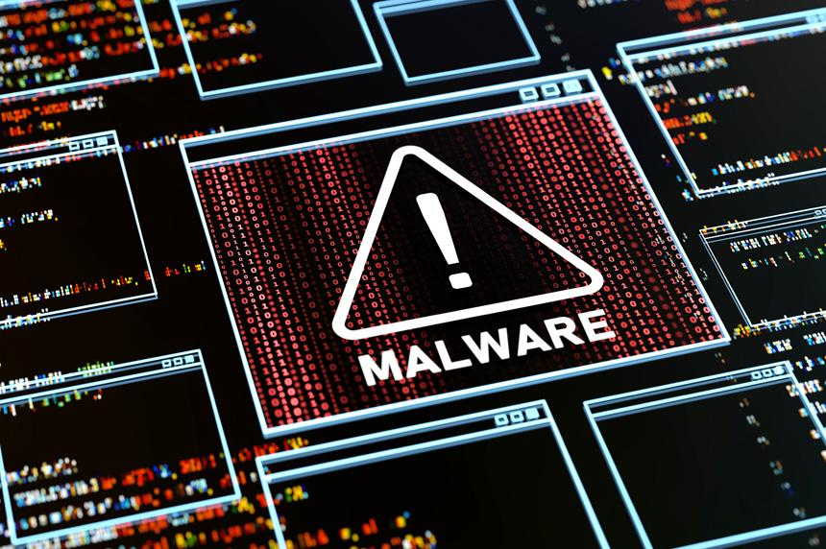
Wellcome To Ethical Hacking class
5th Week Day 3rd

Slide 2
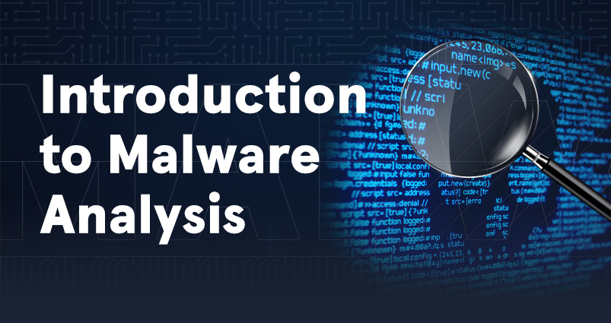
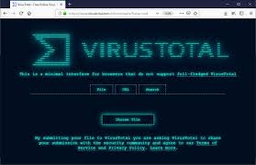
Introduction to Malware Analysis
Definition: Malware analysis is the process of studying malware to understand its behavior, functionality, and potential impact on a system or network. The goal is to identify the threat, develop mitigation strategies, and improve cybersecurity defenses.
Examples:
1.Analyzing a ransomware variant to determine its encryption method and potential decryption keys.
2.Examining a phishing email's attached malware to understand how it exfiltrates data.
Techniques:
Reverse engineering
Network traffic analysis
Tools/Websites:
[VirusTotal](https://www.virustotal.com/)
[Hybrid Analysis](https://www.hybrid-analysis.com/)
MALWARE

Slide 3

Malware Analysis Fundamentals
Definition: The fundamentals of malware analysis involve the basic principles and methodologies used to dissect and understand malware, including static, dynamic, and behavioral analysis.
Examples:
1.Using static analysis to review the code of a malicious script without executing it.
2.Applying dynamic analysis to observe the real-time behavior of a malware sample.
Technique:
Signature-based detection
Heuristic analysis
Tools/Websites:
[Cuckoo Sandbox](https://cuckoosandbox.org/)
[IDA Pro](https://hex-rays.com/ida-pro/)
MALWARE

Slide 4

Types of Malware and Malicious Code
Definition: Malware comes in various forms, including viruses, worms, trojans, ransomware, spyware, adware, and rootkits. Each type serves different malicious purposes, such as data theft, espionage, or system disruption.
Examples:
1.Ransomware (e.g., WannaCry): Encrypts files and demands ransom for decryption.
2.Spyware (e.g., keyloggers): Monitors and records keystrokes to steal credentials.
Techniques:
Classification based on behavior and intent
Identifying specific signatures
Tools/Websites:
[Malwarebytes](https://www.malwarebytes.com/)
[Avast Threat Labs](https://www.avast.com/c-threat-lab)
MALWARE

Slide 5

Malware Analysis Environments and Sandboxes
Definition: A controlled environment, like a sandbox, is used to safely execute and analyze malware without risking the host system or network. This allows researchers to observe the malware’s behavior in a contained setting.
Examples:
1.Using a virtual machine with no network connection to analyze malware.
2.Employing a cloud-based sandbox to safely run and examine malware behavior.
Techniques:
Setting up isolated virtual environment
Using automated sandboxes for dynamic analysis
Tools/Websites:
[Cuckoo Sandbox](https://cuckoosandbox.org/)
[Joe Sandbox](https://www.joesecurity.org/)
MALWARE

Slide 6
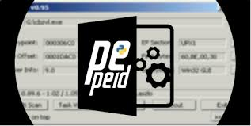
Static Analysis Techniques
Definition: Static analysis involves examining the malware’s code, structure, and metadata without executing it. This helps in understanding its composition, possible functions, and potential impact.
Examples:
1.Examining the file headers of a malware sample to identify its type and origin.
2.Analyzing embedded strings within the malware to uncover URLs or IP addresses it might contact.
Techniques:
Binary analysis
Signature extraction
Tools/Websites:
[PEiD](https://www.aldeid.com/wiki/PEiD)
[Ghidra](https://ghidra-sre.org/)
MALWARE

Slide 7

Dynamic Analysis Techniques
Definition: Dynamic analysis involves running the malware in a controlled environment to observe its behavior, interactions with the system, and any changes it makes. This method helps in understanding how the malware operates in real-time.
Examples:
1.Monitoring network traffic** to see if the malware connects to a command-and-control server.
2.Tracking file system changes** made by the malware, such as creating or modifying files.
Techniques:
Process monitoring
Network traffic analysis
Tools/Websites:
[Process Monitor (Procmon)](https://docs.microsoft.com/en-us/sysinternals/downloads/procmon)
[Wireshark](https://www.wireshark.org/)

Slide 8

Behavioral Analysis of Malware
Definition: Behavioral analysis focuses on understanding the actions malware takes during execution, such as creating new processes, modifying files, or changing registry settings.
Examples:
1.Observing a malware sample that creates a hidden process to avoid detection.
2.Tracking registry changes made by a trojan to ensure persistence on the system.
Techniques:
System call tracing
File system monitoring
Tools/Websites:
[Regshot](https://sourceforge.net/projects/regshot/)
[Sysmon](https://docs.microsoft.com/en-us/sysinternals/downloads/sysmon)

Slide 9
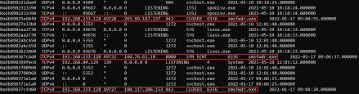

Memory Analysis and Forensics
Definition: Memory analysis involves examining the contents of a system's RAM to detect and analyze running malware, uncover hidden processes, and understand the impact on the system.
Examples:
1.Dumping the memory of a compromised system to identify an injected malicious process.
2.Using memory forensics to recover encryption keys or other sensitive data stored temporarily in RAM.
Techniques:
Memory dumping
Volatile data analysis
Tools/Websites:
[Volatility](https://www.volatilityfoundation.org/)
[Rekall](https://github.com/google/rekall)
MALWARE

Slide 10

Disassembling and Debugging Malicious Code
Definition: Disassembling converts malware binaries into human-readable assembly code, while debugging involves running the malware step-by-step to understand its logic and flow.
Examples:
1. Disassembling a packed malware sample to reveal its true instructions.
2. Using a debugger to trace through the execution of a malware's encryption routine.
Techniques:
Reverse engineering
Instruction tracing
Tools/Websites:
[OllyDbg](http://www.ollydbg.de/)
[Ghidra](https://ghidra-sre.org/)

Slide 11

Code Injection and Hooking Techniques
Definition: Code injection involves inserting malicious code into another process's address space, while hooking refers to intercepting function calls or messages to alter the behavior of a system or software.
Examples:
1.DLL injection: Injecting a malicious DLL into a legitimate process to gain control.
2.API hooking: Altering the behavior of system functions to evade detection or capture user inputs.
Techniques:
Remote thread injection
Inline hooking
Tools/Websites:
[Process Hacker](https://processhacker.sourceforge.io/)
[Cheat Engine](https://cheatengine.org/)

Slide 12

Deobfuscation and Decryption
Definition: Deobfuscation is the process of reversing obfuscation techniques used by malware to hide its code, while decryption involves breaking the encryption used to protect or disguise malicious payloads.
Examples:
1.Deobfuscating JavaScript code in a malicious web page to reveal its true intent.
2.Decrypting ransomware-encrypted files to restore them without paying the ransom.
Techniques:
Code pattern recognition
Cryptanalysis
Tools/Websites:
[CyberChef](https://gchq.github.io/CyberChef/)
[Radare2](https://rada.re/n/)
MALWARE

Slide 13
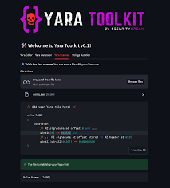

YARA Rules for Malware Detection
Definition: YARA is a tool used to identify and classify malware by creating rules based on known patterns, strings, and behaviors associated with specific malware families.
Examples:
1.Writing a YARA rule to detect a specific variant of a trojan based on its unique strings.
2.Using YARA to scan a file system for known malware signatures.
Techniques:
Pattern matching
Signature-based detection
Tools/Websites:
[YARA](https://virustotal.github.io/yar
[Yara Rules Repository](https://github.com/Yara-Rules/rules)
MALWARE

Slide 14
Thank You!

